Slide 1
Celebrating women and children peacemakers

Slide 2
Blessed are the Peacemakers …
Peacemaker …
Occurs only one time in the whole of the Gospels.
It’s a made-up word … but not in a careless way. In a very careful way.
Let’s look at how full of meaning it truly is …

Slide 3
Matthew 5:9
New International Version
Blessed are the peacemakers, for they will be called children of God.
New Living Translation
God blesses those who work for peace, for they will be called the children of God.
English Standard Version
“Blessed are the peacemakers, for they shall be called sons of God.
New American Standard Bible
"Blessed are the peacemakers, for they shall be called sons of God.
King James Bible
Blessed are the peacemakers: for they shall be called the children of God.
Holman Christian Standard Bible
The peacemakers are blessed, for they will be called sons of God.
International Standard Version
"How blessed are those who make peace, because it is they who will be called God's children!
NET Bible
"Blessed are the peacemakers, for they will be called the children of God.
Aramaic Bible in Plain English
Blessed are they who make peace, for they will be called the children of God.

Slide 4
BLESSED

Slide 5
PEACE + MAKER

Slide 6
PEACE = IRENIC
+ TO MAKE

Slide 7
PEACE = IRENIC
+ POEM

Slide 8
Have you ever tried to write a poem?

Slide 9

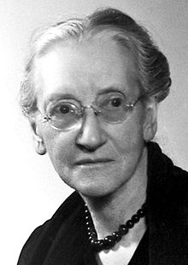
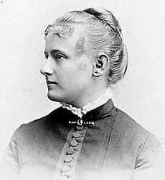

Who are the peacemakers?
Champions of Social Justice
Fannie Lou Hamer
Emily Greene
Balch
Vida Dutton Scudder
Notes:
Fanny Lou Hamer (Oct 6)
The Civil Rights leader who “got sick and tired of being sick and tired.”
Before she stood up to speak on behalf of African American’s being second class citizens
Born to a Mississippi sharecropper she joined organizations to register AA’s to vote
Caused her to get fired from her sharecropping work
Vida Scudder

Slide 10
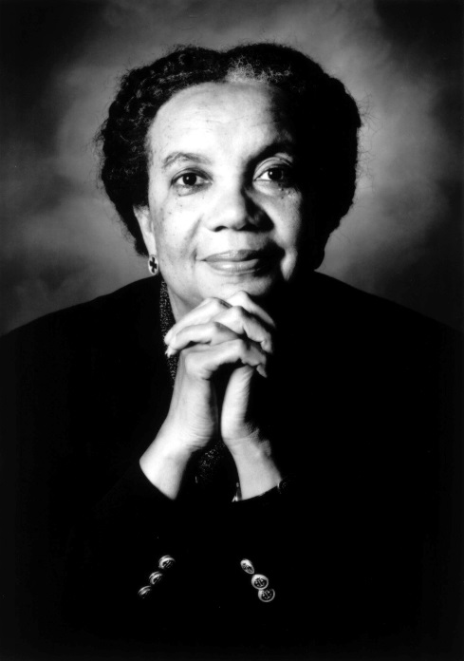
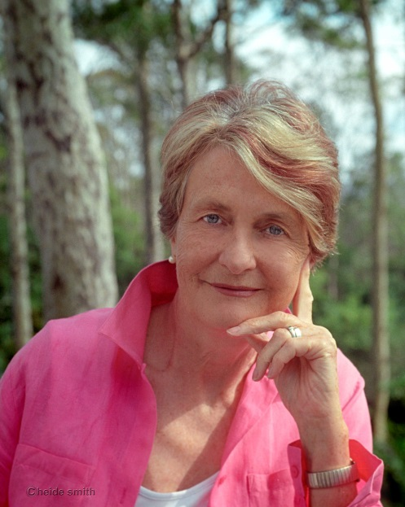
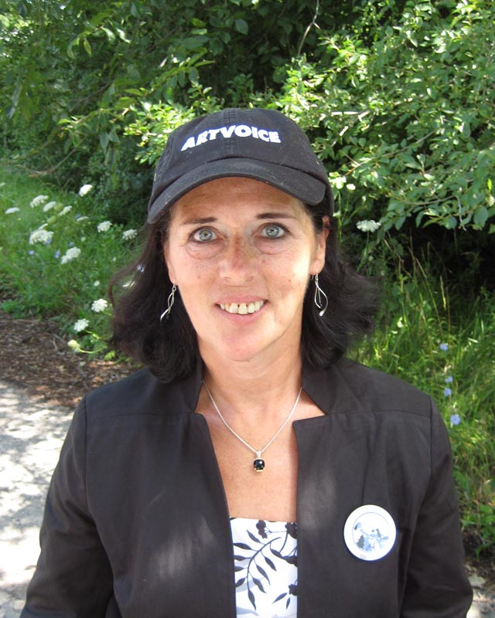
Who are the peacemakers?
Champions of Children
Lois Marie Gibbs
Marian Wright Edelman
Helen Caldicott
Notes:
Marian Edelman June 6
Helen Caldicott: nuclear power is a hell of a way to boil water … August 7
Gibbs June 25

Slide 11
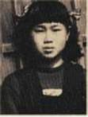
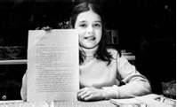
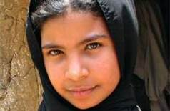
Who are the peacemakers?
Children
Samantha Smith
Sadako Sasaki
Najood Ali
Notes:
Samantha Smith (June 29)
The Cold War era child who encouraged Soviet and American kids to bridge the gap between their nations.
Sadako Sasaki (Jan 7)
The Japanese girl who made the paper crane a worldwide symbol of peace.
Nujood Ali (Sept 27)
Forced into marriage at age 8, she defied Yemenese child-bride laws.
Highlight: Najood Ali

Slide 12
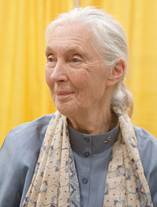
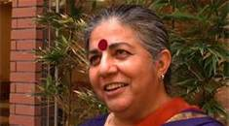
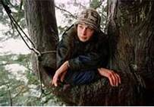
Who are the peacemakers?
Jane Goodall
Environmentalists
Julia Butterfly Hill
Vandana Shiva
Notes:
Jane Goodall April 3
Julia Butterfly Hill (Feb 18)
Who lived for 738 days and nights in a California redwood to protect it and surrounding trees from clear cutting.
Vandana Shiva (Nov 5)
Who struggles against agri-industry to protect the earth and the small farmers who depend on it.
Highlight: Vandana Shiva

Slide 13
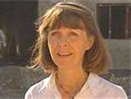
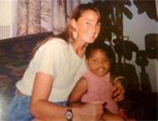
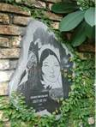
Who are the peacemakers?
Martyrs
Margaret Hassan
Nhat Chi Mai
Amy Biehl
Notes:
Margaret Hassan (April 18)
Relief worker, head of Iraq CARE, murdered by jihadists.
Amy Biehl (April 26)
Murdered in South Africa while working for women’s rights.
Nhat Chi Mai (May 16)
Vietnamese Buddhist nun who self-immolated to protest the war.

Slide 14
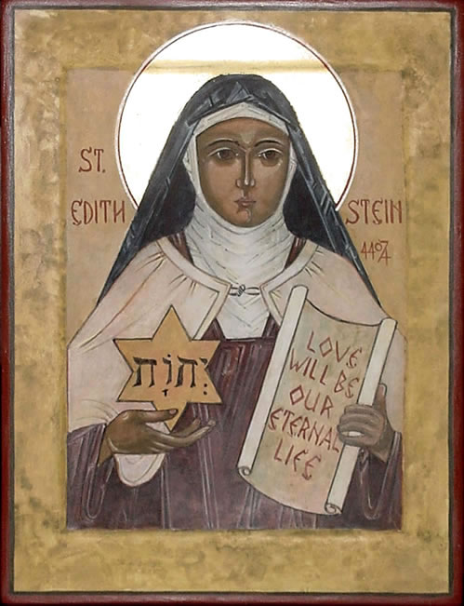
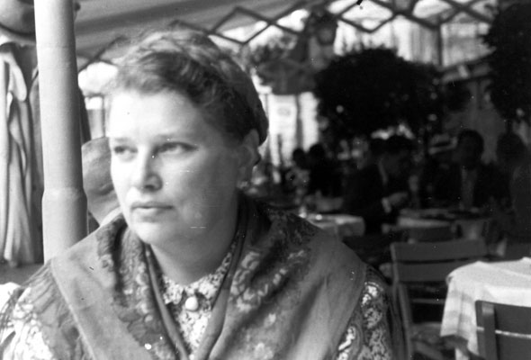
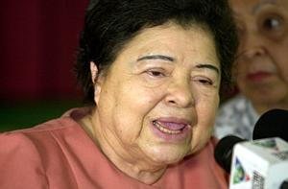
Who are the peacemakers?
Religious
Edith Stein
Julia Hernandez
Catherine Doherty
Notes:
Edith Stein October 12
Catherine August 17
Julia Hernandez January 23

Slide 15
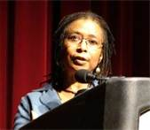
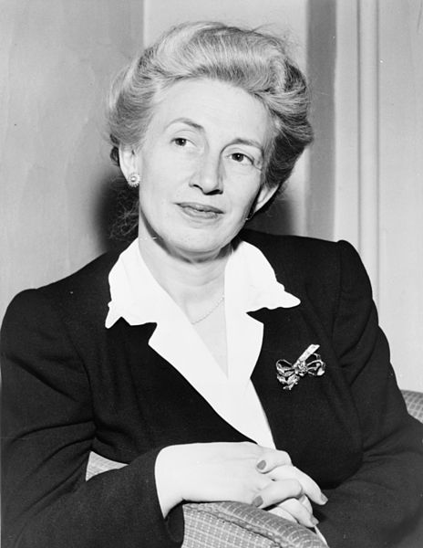
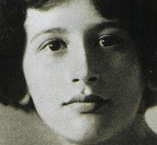
Who are the peacemakers?
Writers
Alice Walker
Lillian Smith
Simone Weil
Notes:
Alice Walker (Feb 9)
She believes the lives of all sentient beings are sacred.
Lillian Smith September 28
Simone Weil, Feb. 26

Slide 16
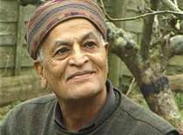
What did we learn about peacemakers?
  Look at what realists have done for us. They have led us to war and climate change, poverty on an unimaginable scale, and wholesale ecological destruction. Half of humanity goes to bed hungry because of all the realistic leaders in the world.
Satish Kumar
Notes:
Peace and Justice are intimately linked
Violence is a violation
Indiscriminate
Corrupts anyone who engages violence
Peace does not mean conflicts magically disappear
Peace is both
External (state of concord)
Internal (state of tranquility)
What links us with peacemakers is a shared desire to be “instruments of peace
This year’s worth of peacemaker stories helps us sustain this desire
Our hope in writing this book was that there was one person, one life, one quote, one story that would start everyone on the journey of making peace. Many people may consider this journey too idealistic or unrealistic. But as Indian born philosopher Satish Kumar has said: Look at what realists have done for us. They have led us to war and climate change, poverty on an unimaginable scale, and wholesale ecological destruction. Half of humanity goes to bed hungry because of all the realistic leaders in the world.

Slide 17
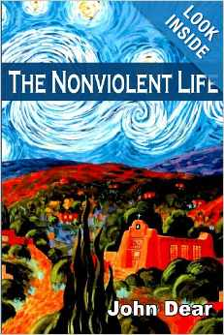
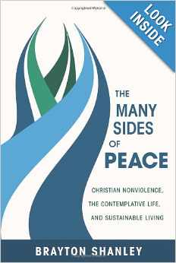
Practicing Peacemaking …
Two books that can be helpful in our understanding of the art of creating and living peace …
Notes:
We will be using some ideas from The Nonviolent life for our exercises this afternoon.
The Many Sides of Peace is a far more radical work, but I highly recommend it.

Slide 18
Practicing Peacemaking …
Dr. King’s Way of Nonviolence:
Nonviolence is the way of the strong
The goal of nonviolence is redemption and reconciliation.
Nonviolence seeks to defeat evil, not people.
Nonviolence includes a willingness to accept suffering without retaliation, to accept blows from the opponent without striking back.
Nonviolence avoids not only external violence but also internal violence of spirit.
Nonviolence is based on the conviction that the universe is on the side of Justice (Micah 6:8)
Notes:
We will be using some ideas from The Nonviolent life for our exercises this afternoon.
The Many Sides of Peace is a far more radical work, but I highly recommend it.

Slide 19
Practicing Peacemaking …
Nonviolence toward ourselves
Nonviolence toward others
Joining for nonviolence globally
Notes:
We will be using some ideas from The Nonviolent life for our exercises this afternoon.
The Many Sides of Peace is a far more radical work, but I highly recommend it.

Slide 20
Practicing Peacemaking …
How do you define nonviolence?
How are you violent to yourself? How do you put yourself down, hurt yourself, cultivate inner violence and perpetuate violence, resentment and hatred?
Notes:
We will be using some ideas from The Nonviolent life for our exercises this afternoon.
The Many Sides of Peace is a far more radical work, but I highly recommend it.

Slide 21
Practicing Peacemaking …
How are you violent to yourself? How do you put yourself down, hurt yourself, cultivate inner violence and perpetuate violence, resentment and hatred?
Violence Toward Ourselves: (From the Group of women at the Day of Renewal Retreat):
Not adequate enough – abusing substances
“You’re a girl.” You can’t do that.
Do for everyone else. But not you.
Holding on to anger/grudges. Isolation. Stress.
Notes:
We will be using some ideas from The Nonviolent life for our exercises this afternoon.
The Many Sides of Peace is a far more radical work, but I highly recommend it.

Slide 22
Practicing Peacemaking …
Who challenges our nonviolence most? How do we practice nonviolence to those who are violent toward us? Where do we find the God of peace as we practice interpersonal nonviolence?
Notes:
We will be using some ideas from The Nonviolent life for our exercises this afternoon.
The Many Sides of Peace is a far more radical work, but I highly recommend it.

Slide 23
Practicing Peacemaking …
Who challenges our nonviolence most? How do we practice nonviolence to those who are violent toward us? Where do we find the God of peace as we practice interpersonal nonviolence? (Day of Renewal women):
How do we model peace and justice?
Ourselves getting in the way …
Witnessing violence and how to respond
Avoiding conflict
IntrA-personal (social media)
Not reacting in kind
Notes:
We will be using some ideas from The Nonviolent life for our exercises this afternoon.
The Many Sides of Peace is a far more radical work, but I highly recommend it.

Slide 24
Practicing Peacemaking …
What nonviolent movements and nonviolent actions have you participated in? Where do we see the hope and power of active nonviolence working in the world today?
What global grassroots movement of nonviolence are you part of or do you wish to join?
Notes:
We will be using some ideas from The Nonviolent life for our exercises this afternoon.
The Many Sides of Peace is a far more radical work, but I highly recommend it.

Slide 25
Practicing Peacemaking …
What nonviolent movements and nonviolent actions have you participated in? Where do we see the hope and power of active nonviolence working in the world today?
What global grassroots movement of nonviolence are you part of or do you wish to join?
Washington/State Capitol
Taking to the young folks
Lutheran World Relief
Heifer International
Global starts at home
Community Dinners
Youth involvement with Global issues
Ask, then LISTEN
Local is Global.
Notes:
We will be using some ideas from The Nonviolent life for our exercises this afternoon.
The Many Sides of Peace is a far more radical work, but I highly recommend it.

